Slide 1


Slide 2
DAX from the Field
Alberto Ferrari alberto.ferrari@sqlbi.com twitter @FerrariAlberto

Slide 3


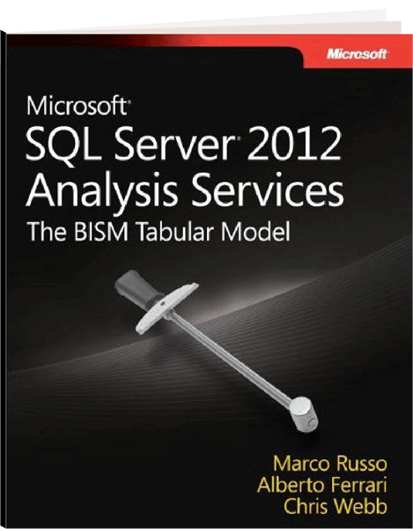

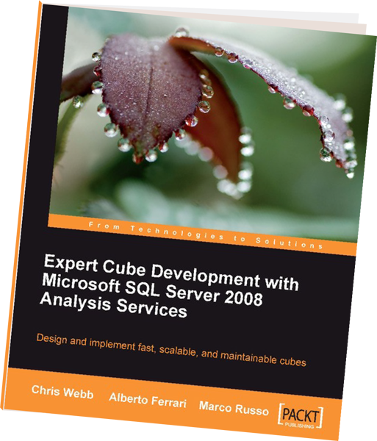





Who’s Speaking?
a brand of
BI Expert and Consultant
Founder of www.sqlbi.com
Problem Solving
Complex Project Assistance
Data Warehouse Assessments and Development
Courses, Trainings and Workshops
Book Writer
Microsoft Business Intelligence Partner

Slide 4
SSAS Multidimensional and MDX
OLAP data structures
Proprietary and complex data structure
Complex design of solutions
Requires highly-optimized databases
Runs on expensive hardware
Design of aggregation is an obscure art
MDX Language
Hard to learn, fast only with his closest friends
Requires complex modelling skills

Slide 5
SSAS Tabular and DAX
xVelocity in-memory Analytics Engine
In-memory database
Columnar storage
Automatically compresses data
Already optimized out-of-the-box
Runs on commodity hardware (inside Excel in a laptop!)
DAX Language
Easy to learn, amazingly fast
Requires less modelling skills to achieve great results

Slide 6
SSAS Tabular in the real world
xVelocity in-memory Analytics Engine
Handles billions of rows
Optimizing columnar storage often requires fancy ideas
Compressing data is a major challenge
Optimized out-of-the-box, if you run AdventureWorks
Finding the proper hardware requires extensive testing
DAX Language
Easy to learn, very hard to master (like SQL)
Requires great efforts to achieve optimal results

Slide 7
Agenda
Focus is on large Tabular solutions
Optimizing columnar databases
Understanding the distinct count issue
Sizing the hardware
Writing good DAX code
Performance analysis

Slide 8
VertiPaq

Slide 9
Row Storage Layout
Customers Table
ID | Name | Address | City | State | Bal Due
1 | Bob | … | … | … | 3,000
2 | Sue | … | … | … | 500
3 | Ann | … | … | … | 1,700
4 | Jim | … | … | … | 1,500
5 | Liz | … | … | … | 0
6 | Dave | … | … | … | 9,000
7 | Sue | … | … | … | 1,010
8 | Bob | … | … | … | 50
9 | Jim | … | … | … | 1,300
1 | Bob | … | … | … | 3,000
2 | Sue | … | … | … | 500
3 | Ann | … | … | … | 1,700
4 | Jim | … | … | … | 1,500
5 | Liz | … | … | … | 0
6 | Dave | … | … | … | 9,000
7 | Sue | … | … | … | 1,010
8 | Bob | … | … | … | 50
9 | Jim | … | … | … | 1,300
Nothing special here.
This is the standard way database systems have been laying out tables on disk since the mid 1970s.
Technically, it is called a “row store”

Slide 10
Column Storage Layout
Customers Table
ID | Name | Address | City | State | Bal Due
1 | Bob | … | … | … | 3,000
2 | Sue | … | … | … | 500
3 | Ann | … | … | … | 1,700
4 | Jim | … | … | … | 1,500
5 | Liz | … | … | … | 0
6 | Dave | … | … | … | 9,000
7 | Sue | … | … | … | 1,010
8 | Bob | … | … | … | 50
9 | Jim | … | … | … | 1,300
ID
1
2
3
4
5
6
7
8
9
Name
Bob
Sue
Ann
Jim
Liz
Dave
Sue
Bob
Jim
Address
…
…
…
…
…
…
…
…
…
City
…
…
…
…
…
…
…
…
…
State
…
…
…
…
…
…
…
…
…
Bal Due
3,000
500
1,700
1,500
0
9,000
1,010
50
1,300
Tables are stored “column-wise” with all values from a single column stored in a single block

Slide 11
Run Length Encoding
Quarter
Q1
Q1
Q1
Q1
Q1
Q1
…
Q2
Q2
Q2
Q2
Q2
Q2
Q2
Q2
Q2
…
ProdID
1
1
1
1
1
2
2
2
…
1
1
1
1
1
2
2
2
Price
100
120
315
100
315
198
450
320
320
150
256
450
192
184
310
251
266
Quarter | Start | Count
Q1 | 1 | 310
Q2 | 311 | 290
… | … | …
Price
100
120
315
100
315
198
450
320
320
150
256
450
192
184
310
251
266
ProdID | Start | Count
1 | 1 | 5
2 | 6 | 3
… | … | …
1 | 51 | 5
2 | 56 | 3
RLE Compression applied only when size of compressed data is smaller than original

Slide 12
Dictionary Encoding
Only 4 values. 2 bits are enough to represent it
Quarter
Q1
Q1
Q1
Q1
Q2
Q2
…
Q2
Q3
Q3
Q3
Q3
Q4
Q4
Q4
Q4
…
Q.ID
0
0
0
0
1
1
…
1
2
2
2
2
4
4
4
4
…
Q.ID | Quarter
0 | Q1
1 | Q2
2 | Q3
3 | Q4
xVelocity Store
DISTINCT
R.L.E.
Quarter | Start | Count
0 | 1 | 4
1 | 5 | 10
2 | 11 | 4
3 | 15 | 15

Slide 13
DISTINCT COUNT
Reducing the number of distinct values of columns
Reduces the memory usage of the model
Increases scan speed
Increases filter operations
Focus on columns with many distinct values
Primary keys in fact tables
Order number / reference numbers

Slide 14
Modeling
DEMO

Slide 15
Modeling columns: the results
Column | Memory (MB) | Distinct Values | SUM | DISTINCTCOUNT
Age | 203.55 | 96 | 130 | 103
Time | 6,192.81 | 1,438 | 1,391 | 844
Date | 0.37 | 1,588 | 13 | 17
Weight | 2,690.35 | 1,467,394 | 700 | 1,986
Base query time depends on
Number of distinct values of the column (bit encoding)
Distribution of values (RLE encoding)
Do you prefer to optimize date or time in this model?

Slide 16
Reducing Distinct Count
Reduce precision of numbers
Split date and time in two tables
Never use DateTime
Split high cardinality columns in two parts
You can combine them later during calculations
<Num> = <High> * 1000 + <Low>

Slide 17
Predicting Database Size
Build a first prototype
Few millions rows from the fact table
All rows for dimensions
Evaluate the base size
Using BISM Memory Report
Add 10% of rows to fact table, evaluate size again
Add 20% of rows, then 30% …
Until you draw a growth curve

Slide 18
Why Forecasting is important?
RAM is a limited resource
You cannot increase it at will
The limit is imposed at the hardware level
Hardware with a lot of RAM is normally NUMA
NUMA hardware makes the scenario much more complex
Choosing the right hardware is a challenge

Slide 19
Buying the Hardware
CPU
The fastest you can buy
Largest L2 cache
Lowest number of cores (less than 8)
RAM
The fastest you can buy
Disk, other hardware
Don’t waste your money here, not used

Slide 20
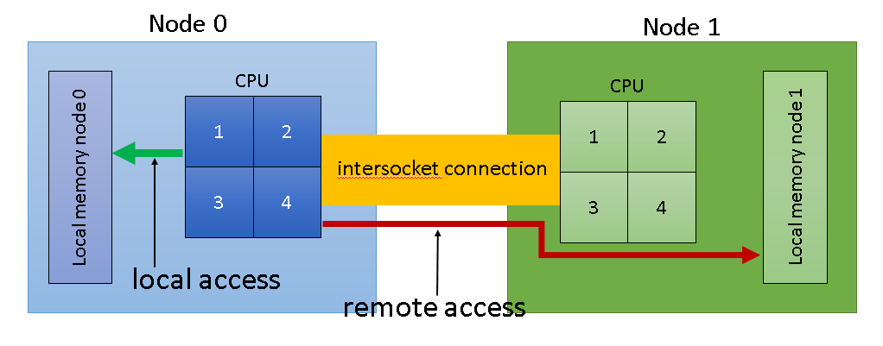
The NUMA Issue

Slide 21
Tabular is not NUMA Aware
The model can be split on different nodes
Performance degrades in a hard-to-predict way
Bad usage of the hardware
Rule of thumb
Less than 4 nodes is good, more is bad
Optimal rule
One node is good, more than one node is bad
Partition the database or the model to make it fit one node

Slide 22
Running in Virtual Machines
Very good option
Chance to update the amount of RAM allocated
Very low impact on performance
Be careful with CPU affinity, if on NUMA
Requires partitioning of the database

Slide 23
Optimizing

Slide 24
The DAX challenge
DAX can be optimized, and run very fast
But this is only one part of the whole story
Other important aspects
Serving many users concurrently
Optimal usage of the cache
Optimizations depend from the client tool
Optimizing DAX is much more expensive than you might think

Slide 25
Events in Progress
How many orders are active each day?
Very common pattern
Whenever you have a duration
i.e. start and end date of an event

Slide 26
Events in Progress: a first trial
Computing Events in Progress
EVALUATE
ADDCOLUMNS (
VALUES ( 'Date'[Date] ),
"OpenOrders",
COUNTROWS (
FILTER (
Sales,
Sales[Order Date] < 'Date'[Date] &&
Sales[Ship Date] > 'Date'[Date]
)
)
)

Slide 27
Optimizing Events in Progress
SQL Server Profiler is your best friend
Build a template, saves a lot of time
Understand Formula Engine and Storage Engine
Remember that VertiPaq is a columnar database
We will see 4 variations of the same query

Slide 28
Events in Progress: final results
Version | Formula Engine | Execution Time | Notes
Naïve | 22,078 | 22,175 | First query you will write
Column-wise | 906 | 925 | Query written by a seasoned DAX coder
DatesBetween | 156 | 167 | Original idea (from Chris Webb) you will find in on a blog post
Generate | 78 | 80 | Required 4/5 days of hard optimization
Optimizing DAX leads to great results
But it requires a lot of time
Stop when it is “good enough”
Extreme optimizations need to work on the whole model

Slide 29
Be creative and open minded
DAX is not complex, it is new
DAX is simple, but it is not easy
Writing good DAX requires
Thinking in a creative way
Not trusting any golden rule
Being prepared to optimize the whole model

Slide 30
Which one is better?
Audience contains 4B rows
Weight has 1.5M distinct values
SUMX ( Audience, IF ( Audience[Weight] > 300000, Audience[Weight] ) )
CALCULATE ( SUM ( Audience[Weight] ), Audience[Weight] > 300000 )

Slide 31
Conclusions
Spend time to learn the internals of the engine
Knowing it, is the key to any optimization
Change the way you think at
Data Modelling
Hardware sizing
Formula writing
Don’t trust any rule of thumb, including mine!

